Slide 1

ASSURE MODEL:
LESSON PLAN IN MATHEMATICS 10

Slide 2
Lesson Title: Circle
Grade: 10
Time Allotment: 1 hour
Technologies Integrated:
Teacher: Will use computers to provide feedback, Projector
Students: Will use computers or cellphones to work
  Multiple Intelligences:
  Logical/Mathematical, Verbal/Linguistic

Slide 3
ANALYZE THE LEARNERS:
The class composes of 50 students: 28 girls and 22 boys. Students’ age ranges from 15-17. Majority of the students can read and write, and know the basics of using computer. Students enjoy Mathematics and 75% of the class maintains an average above 65% within the subject area. Students are from a variety of economic and social backgrounds of their learning styles.

Slide 4
ANALYZE THE LEARNERS:
Previous Knowledge:
Students are familiar with the basic concepts of circles (e.g. parts) and illustrate the center- radius form of the equation of a circle.

Slide 5
STANDARDS and OBJECTIVES
Within the period, students are expected to:
Content Standard:
a. Demonstrates understanding of key concepts of circle and coordinate geometry.

Slide 6
STANDARDS and OBJECTIVES
Performance Standard:
a. Is able to formulate and find solutions to challenging situations involving circles and other related terms in different disciplines through appropriate and accurate representations.
b. Is able to formulate and solve problems involving geometric figures on the rectangular coordinate plane with perseverance and accuracy.

Slide 7
STANDARDS and OBJECTIVES
Learning Competency:
a. Determines the circle and radius of a circle given its equation and vice-versa.
b. Graph a circle and other geometric figures on the coordinate plane.
Value Aim: Participation/ Cooperation

Slide 8
SELECT AND UTILIZE TEACHING METHODS/STRATEGIES:
Discussion, question and answer along with the technological tools will be used to teach students how illustrate, determine and graph a circle.
SELECT AND UTILIZE MEDIA:
Laptop
Projector
LCD screen
GeoGebra
Mobile phones

Slide 9
Introduction:
Teachers will inform students that the lesson will be circles. Teacher will ask the students the parts of circles in order to stimulate their previous knowledge. Once selected students have shared their understanding about circle, teacher will share a brief description that will lead to a new topic. The teaching strategies that will be used are Inquiry-Based learning and Experiential learning. Students will explore and discover the content required of the activities.

Slide 10
Procedure:
1. The teacher will prepare the selected media.
2. The teacher will tell the students that if they will not meet the 85% accuracy in determining the circle and radius of a circle given its equation and vice-versa and graphing a circle and other geometric figures on the coordinate planes students are unable to accurately do so, GeoGebra pertains to do so.

Slide 11
Procedure:
3. The GeoGebra app can be used by:
a. The teacher will show how to input an equation of the circle, shown through LCD screen or projector.
b. The students will then follow and try to do it using their phones or laptops, if available.
c. After inputting the equation, the app will eventually process and show the graph of the circle’s equation.

Slide 12
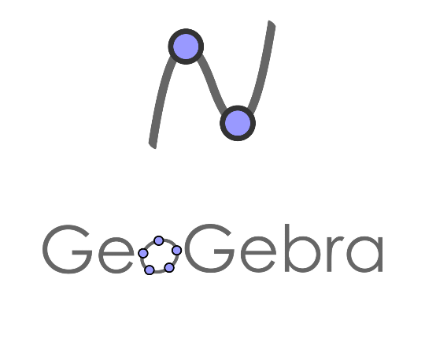
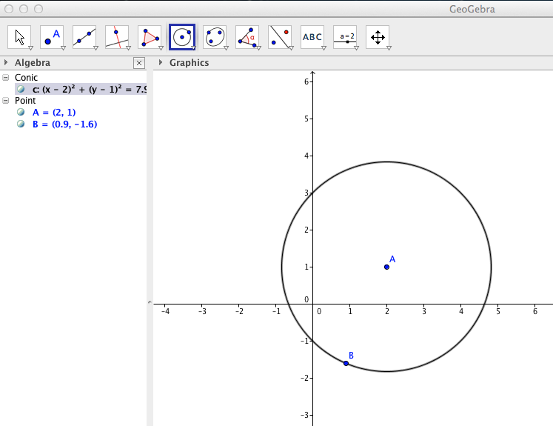
Procedure:

Slide 13
EVALUATE AND REVISE:
Students will be given three (3) equations to solve and illustrate its graph:
1. (X-2)² + (y-3)² = 4
2. X² + y² – 6x +2y + 4 = 0
3. 2x² + 2y² = 8

Slide 14
Reference:
Mathematics Grade 10 Learner’s Module Unit 2

Slide 15
Prepared by:
Shierna R. Gulariza
Samuel M. Tenedero
Daisy P. Domingo

