Slide 1
SAMR Model:
LESSON PLAN IN MATHEMATICS 10

Slide 2
I. OBJECTIVES
Within the period, students are expected to:
Content Standard:
a. Demonstrates understanding of key concepts of circle and coordinate geometry.

Slide 3
I. OBJECTIVES
Performance Standard:
a. Is able to formulate and find solutions to challenging situations involving circles and other related terms in different disciplines through appropriate and accurate representations.
b. Is able to formulate and solve problems involving geometric figures on the rectangular coordinate plane with perseverance and accuracy.

Slide 4
I. OBJECTIVES
Learning Competency:
a. Illustrates the center- radius form of the equation of a circle.
b. Determines the circle and radius of a circle given its equation and vice-versa.
c. Graph a circle and other geometric figures on the coordinate plane.

Slide 5
II. SUBJECT MATTER
Topic: Circle
Reference: Mathematics Grade 10 Learner’s Module Unit 2
Technologies Integrated:
Teacher: Will use computers to provide feedback, Projector
Students: Will use computers and cellphones to work
Multiple Intelligences:
Logical/ Mathematical, Verbal/ Linguistic

Slide 6
III. PROCEDURE
SAMR:
This lesson is beneficial to students because it integrates technology into a Mathematics lesson plan. Students are learning both Mathematic concepts and technology skills both at the same time through the use of various application and technologies. Students may need to use applications such as these throughout the future in college education, so it is nice to start getting them familiar with basic computer function and skills below is how we use SAMR to teach Mathematics lesson.

Slide 7
III. PROCEDURE
This is an introductory lesson on circles designed for grade 10 Mathematics of Catarman National High School. There are 50 grade 10 students composed of 28 girls and 22 boys. This lesson serves as continuation about circles and shows the students how the equation of a circle can be manipulated to change its center and radius.

Slide 8
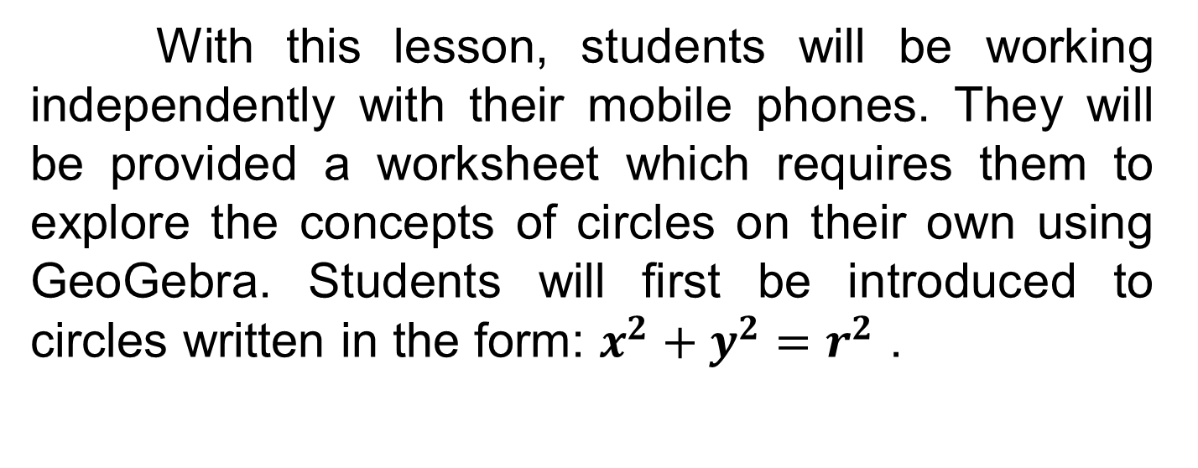
III. PROCEDURE

Slide 9
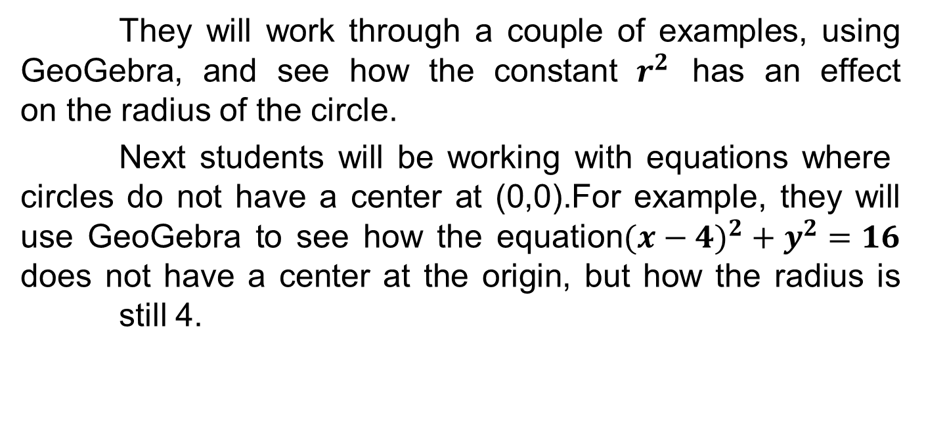
III. PROCEDURE

Slide 10
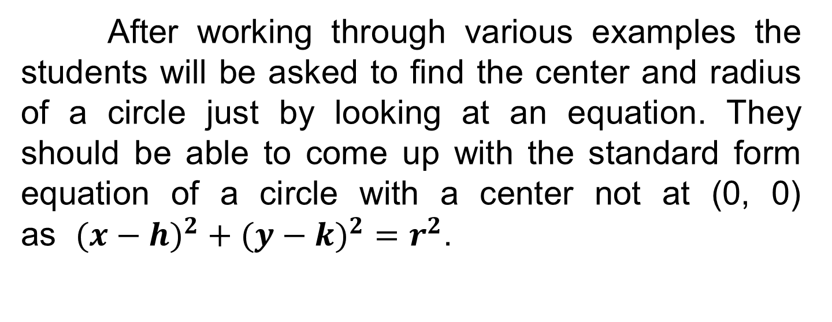
III. PROCEDURE

Slide 11
III. PROCEDURE
At the end of the lesson students will need to complete a short three question quiz posted on the class’s Blog. The three question quiz will serve as a formative assessment for the lesson. This will show how the students performed on the quiz and address any issues that arise, the next day in class.

Slide 12
Substitution:
Use an application called GeoGebra app to let students enter the equation to show the graph of the circle.

Slide 13
Augmentation:
Students will use an application called GeoGebra Application, which is a technology that mixes geometry with algebra. For this lesson students will be working with concepts from both geometry and algebra. They will be working with circles and seeing how equations can change the graph of a circle. Since this lesson incorporates a combination of geometry and algebra, GeoGebra is the ideal technology to use.

Slide 14
Modification:
Students screen capture the graph of the circle’s equation they come up on the GeoGebra Application (using either laptop or cellphone) and use them to create a screencast (video) about their learning to share with others.

Slide 15
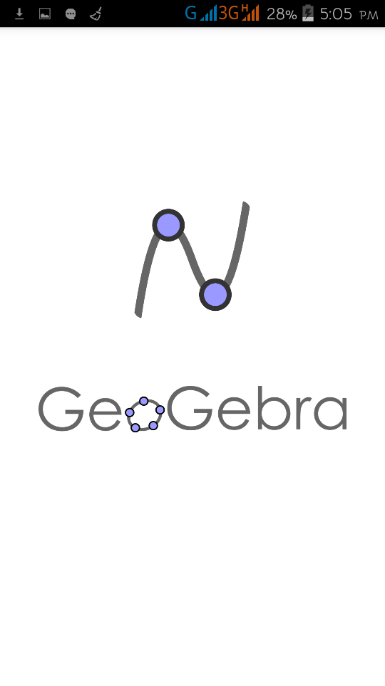
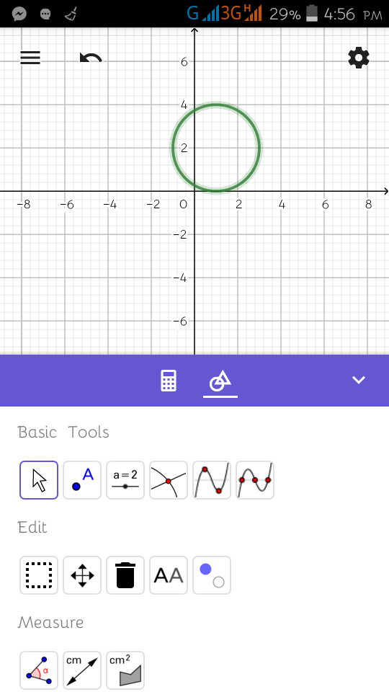
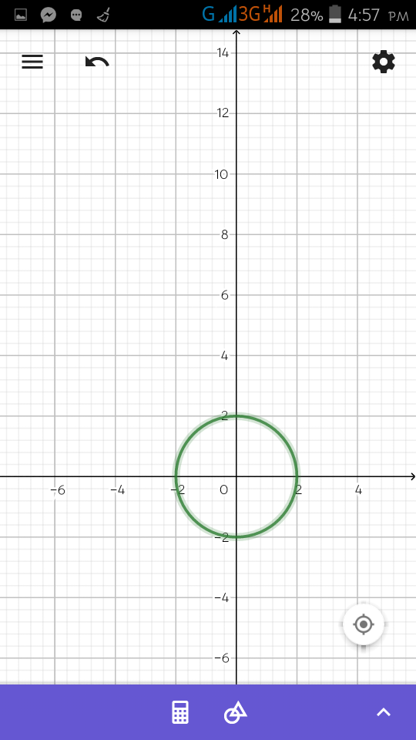

Slide 16
Redefinition:
Each student will create a blog to which they will upload his/her outputs so that others can comment, share and compare regarding the individual outputs uploaded.

Slide 17
Prepared by:
Shierna R. Gulariza
Samuel M. Tenedero
Daisy P. Domingo

